Slide 1
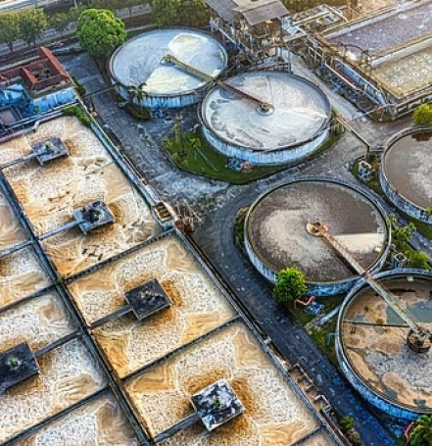
GROUP 2
IDENTIFYING THE POTENTIAL CAUSES FOR INEFFICIENT SEWAGE MANAGEMENT AND TREATMENT IN INDIA
Group Members
Akanksha
Alok
Aman Singh
Anand Prakash
Anshul Bajaj
[220004005]
[220004006]
[220004007]
[220004008]
[220004009]

Slide 2
CONTENTS
1.Types of treatment
2.Sewage treatment in Developed Countries-
2.1. Spain
3. Sewage treatment in Developing Countries-
3.1. Bangladesh
3.2. India
3.2.1. Kanpur
3.2.2. Indore
3.2.3. Delhi
4.Challenges
5.Conclusion
1

Slide 3
TYPES OF TREATMENTS
This initial stage involves physical processes to remove solid particles and some organic matter from wastewater. It typically includes processes like screening, sedimentation, and flotation to separate larger solids from the water.
PRIMARY TREATMENT
Following primary treatment, secondary treatment focuses on biological processes to further break down organic matter and remove nutrients. Common methods include activated sludge, trickling filters, or other biological treatment processes where microorganisms decompose organic materials.
SECONDARY TREATMENT
The final stage, tertiary treatment, is employed to further polish the water before discharge into the environment. It involves advanced processes such as filtration, disinfection, and chemical precipitation to remove remaining contaminants, pathogens, and nutrients to meet regulatory standards.
DISINFECTION AND TERTIARY TREATMENT
2

Slide 4
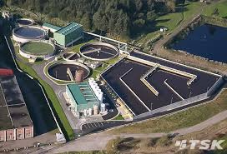
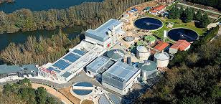
SEWAGE TREATMENT IN DEVELOPED COUNTRY
SPAIN
Spain's water resources are being stressed by rising water demands and frequent instances of water stress, especially in the Mediterranean region [1][2]. .
According to the report, there are 136 WWTPs in Mediterranean Spain in total, with a variety of plant sizes and treatment methods [1][3]. The autonomous communities of Andalusia, Catalonia, Madrid, Valencia, and Murcia are home to the largest plants and are also the primary producers of treated wastewater in the nation [1][2]. Public-private facilities have the most advanced treatment systems and are also the biggest in terms of size [2].
Spain has an extensive sewage treatment system that comprises sludge treatment as well as preliminary, primary, secondary, and tertiary treatment stages [1][2].
Sludge Treatment
In Spain, sludge treatment plays a significant role in the sewage treatment process. Sludge is the primary by-product of wastewater treatment and needs to be appropriately managed. This covers procedures including stabilization, thickening, dewatering, and disposing of or reusing the sludge [1].
3

Slide 5
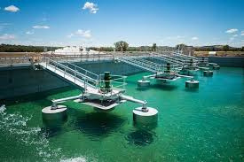
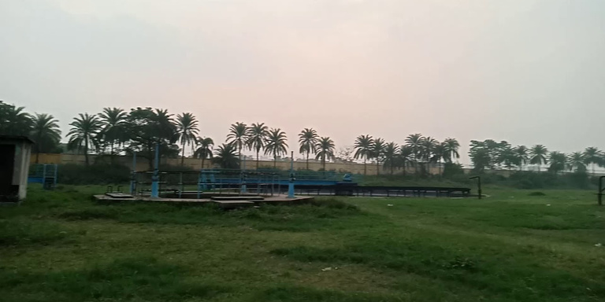
SEWAGE TREATMENT IN DEVELOPING COUNTRY
BANGLADESH
With more than 21 million people living there, Dhaka, the capital of Bangladesh, is among the world's most densely inhabited cities. Sewage generation has increased as a result of the city's fast industrialization and urbanization, placing a heavy burden on the sewage treatment system. The Pagla Sewage Treatment Plant (PST), which has a 120 MLD design capacity, is the only sewage treatment facility in Dhaka [4].
The PST was created to treat wastewater produced primarily by residential sources, with a small amount also coming from commercial sources such as restaurants, laundry facilities, marketplaces, schools, colleges, workplaces, and retail centers [4].
While larger plants operate in controlled environments and rely on a constant supply of oxygen to meet their treatment needs, the basic, open treatment system is powered by the sun and air.
The PST features a design capacity of 120 MLD, 49,000 domestic sewage connections, 778 km of varying diameter sewer line, 20 lift stations for sewage, and one central pump station [4].
4

Slide 6
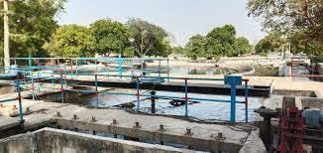
SEWAGE TREATMENT IN DEVELOPING COUNTRY
INDIA
KANPUR
This city is home to the first-ever full-scale UASB demonstration facility for municipal wastewater in the world. It was constructed and put into service in 1989. The facility was built to handle 5 million liters of household wastewater per day, and according to Khan (1995), the biogas yield was 0.1-0.15 m3/kg COD eliminated with a 75%–80% methane gas concentration.
The process used for treating the wastewater is as following-
Wastewater influent --- pumping --- screening --- UASB reactor --- secondary settling tank --- discharged to river
In Kanpur, a 36 MLD unit has been in service since March 1995 (Tare et al. 1997).
5

Slide 7
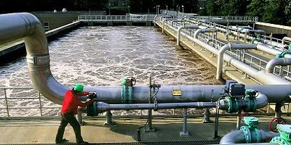
SEWAGE TREATMENT IN DEVELOPING COUNTRY
INDIA
INDORE
The city of Indore is home to four sewage treatment facilities. The daily capacity of each sewage treatment plant to treat wastewater is 70 mld. The efficiency of these plants is between 65 and 75 percent.
Like other cities, Indore lacks a suitable system for gathering wastewater from sewage and an independent system for gathering wastewater from industry.Sewage treatment plants are less able to properly treat the wastewater and have a lower treatment efficiency as a result of the absence of this efficient collecting and separation mechanism.
The process used for treating the wastewater is as following-
Wastewater Influent --- pumping --- screening --- greet chamber
--- primary settling tank --- aeration tank --- secondary settling
---effluent discharge
A study in Indore assessed the impact of sewage sludge and water on soil, water, and environmental health. Samples from treatment facilities were analyzed for pH, nutrients, heavy metals, and pathogens. Results showed high concentrations of nutrients (NPK) and heavy metals (Pb, Ni, Cr, Cd, Hg, As) in sewage sludge. The sewage water, if treated, could potentially irrigate nearly 16,000 hectares of land annually, providing substantial NPK nutrition. However, the high heavy metal content in sewage sludge and effluents poses environmental and phytotoxicity risks, limiting their long-term use in agriculture.
6

Slide 8
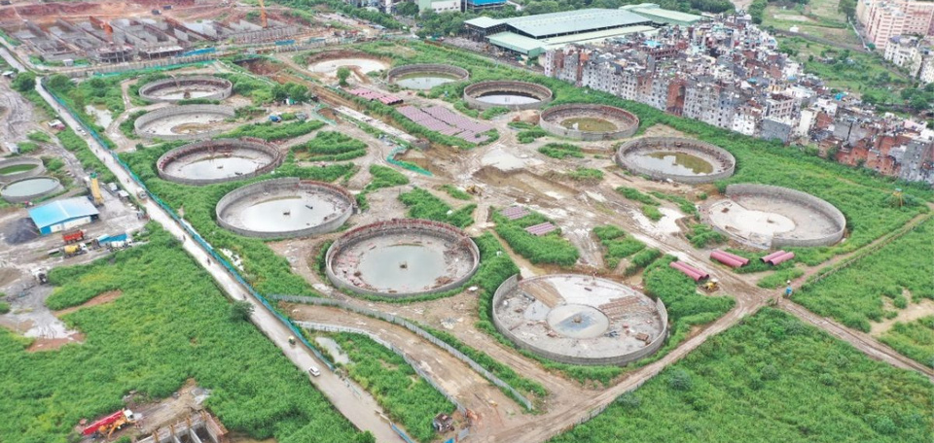
SEWAGE TREATMENT IN DEVELOPING COUNTRY
INDIA
DELHI
Delhi, the capital of India, has a population of over 21 million1, making it one of the world's fastest-growing metropolitan areas. The demand for adequate sewage treatment and disposal facilities arose from the city's increased sewage generation as a result of its rapid population expansion and urbanization.
However, the majority of the wastewater is released into the environment untreated due to inadequate sewage treatment and disposal infrastructure in the city, which pollutes downstream areas [5].
Sewage treatment plants in Delhi consist of several vital components that collaborate to purify wastewater effectively:
Inlet Chamber --- Primary Treatment --- Secondary Treatment
--- Sludge Handling --- Effluent Disposal
After more than ten years of work and Rs. 872crore in expenses since 1994, the Yamuna river's water quality remains far below normal despite efforts to develop sewage treatment infrastructure [5]. Aerobic bioreactors can also effectively handle the modest levels of polycyclic aromatic hydrocarbons found in sewage sludge [6]. Clustering techniques and the use of hierarchical categorization methodologies could reduce the amount of money and labor needed for the monitoring of various sites [6].
7

Slide 9
Technical
Political
Economical
CHALLENGES
CHALLENGES FACED IN WATER TREATMENT PLANTS OF INDIA
Managerial
8

Slide 10

Aging infrastructure: The deterioration of pipelines, tunnels, dams, pumps, and other equipment owing to time and usage [7].
Aging Workforce: The operation and maintenance of treatment facilities are impacted by a shortage of skilled workers resulting from an aging workforce [7].
Energy Consumption: Considerable energy is used, particularly during biological treatment procedures, which makes sustainable operations difficult [7].
Sludge Management: Handling and disposing of sludge generated during the treatment process appropriately to prevent harm to the environment [7].
Land Availability: Because of urbanization and population increase, it is difficult to get enough land for the construction of treatment plants [7].
TECHNICAL AND MANAGERIAL CHALLENGES
9

Slide 11

ECONOMICAL CHALLENGES
High Initial Investment: Establishing a wastewater treatment plant requires a significant initial investment in infrastructure, technology, and equipment.
Operating Costs: The ongoing operational expenses of wastewater treatment plants include energy costs, chemical costs for treatment processes, labor costs, and maintenance expenses
Sewage treatment capacity is lacking in comparison to the rapidly urbanizing scenario due to the high expense of constructing and maintaining sewage treatment plants (STPs) and the government's difficulty meeting construction targets.
Adding to the problem is industrial waste, which raises the expense of water treatment and makes it unfeasible for democratic governments to provide their constituents with modern sewage systems [7].
10

Slide 12

Private Companies Limited in City Water Systems:
Big money in water makes private companies less interested in helping with city water systems.
Companies Want a Piece of the Pie:
Groups like the Confederation of Indian Industry (CII) really want to make money in the water business.
Everyone Needs to Work Together:
We all—companies, government, and people—have to team up to make water better.
POLITICAL CHALLENGES
Pricing Water Fairly is Tricky:
Making sure poor people can afford water while companies still make money from fancy treatment is hard.
11

Slide 13
CONCLUSION
India's sewage treatment system faces numerous challenges that require a comprehensive approach for improvement. Enhancements could be made through the following measures:
1.Decentralized Wastewater Treatment Systems (DEWATS): By treating wastewater closer to the source, DEWATS allow for more efficient reuse of water for things like gardening and toilet flushing. These systems can function up to 80% cheaper than conventional technologies since they rely on gravity, plants, and naturally occurring microbes rather than power and chemicals [9].
2.Appropriate Technology: For sustainable sewage treatment in India, it is imperative to employ appropriate technology, such as affordable, straightforward, and reuse-and-recycle-focused solutions. Decentralized approaches that make use of plants and some bacteria that are connected with them are efficient and reasonably priced, making them appropriate for reuse and gradual improvement.
[8].
12

Slide 14
CONCLUSION
3.Technology Selection: The selection of technology is contingent upon various project-specific factors, such as the criteria regarding effluent quality, the availability of land, energy requirements, and costs. For instance, the highest rate of filtration wastewater treatment technology is the membrane bioreactor, or MBR, which is perfect for locations where land is scarce [11].
4.Public opinion: The success of programs aimed at managing wastewater is greatly dependent on public opinion. Campaigns for public awareness and education can influence perceptions of wastewater treatment and encourage the use of sustainable practices [10].
13

Slide 15
References
[1] https://www.passavant-geiger.com/en/case-studies/detail/cambrils-spain
[2] https://www.waterworld.com/home/article/16216132/small-spain-municipality-innovating-wastewater-treatment-with-new-bioaugmentation-technology
[3]https://documents1.worldbank.org/curated/en/507721559627554397/pdf/Environmental-and-Social-Impact-Assessment-of-Pagla-STP-and-Trunk-Mains.pdf
[4] Haq, K. (2006). Environmental-and-Social-Impact-Assessment-of-Pagla-STP-and-Trunk-Mains.pdf. World Bank Documents.
[5] Shreya Gupta, SK Singh, and Vishal Gandhi. A study on Sewage Treatment and Disposal in Delhi. International Journal of Advance Research and Innovation, 2021.
[6] Singh et al. 2004; Frank Laturnus et al. 2007; Foresti et al. 2006; Orhon et al. 1997; Tare et al. 1997; Govt. report 2005; Trably and Patureau 2006; Sato et al. 2005.
[7] Top 9 Challenges of Water and Wastewater Treatment Plants - Euroteck India
[8] Challenges of Sewage Treatment in India, Prof. Shyam R. Asolekar, Centre for Environmental Science and Engineering, Indian Institute of Technology Bombay, gy y Powai, Mumbai
14

Slide 16
References
[9] Fixing India's Sewage Problem, Stanford Social Innovation Review, https://ssir.org/articles/entry/fixing_indias_sewage_problem
[10] Rethinking wastewater management in India, The Third Pole, https://www.thethirdpole.net/en/pollution/waterwaste-management-in-india/
[11] https://www.downtoearth.org.in/news/waste/india-is-adopting-advanced-sewage-wastewater-treatment-tech-but-must-choose-those-that-best-meet-local-needs-92863
15

Slide 17

THANK YOU

